Slide 1
AWS Projects Presentation
Name: Yousef Hassan Yousef Eltobgy
Student ID: 21031713
Email: eltobgyy@gmail.com
Track: AWS Cloud Solution Admin & Architect
Group Code: ALX1_ISS4_M1e

Slide 2
Project 1 -- Building a Highly Available, Scalable Web Application

Slide 3
Introduction
By the end of this project, we created the following:
Deploy a functional web application that runs on a single virtual machine and is backed by a relational database.
Architect a web application to separate layers of the application, such as the web server and database.
Create a virtual network that is configured appropriately to host a web application that is publicly accessible and secure.
Deploy a web application with the load distributed across multiple web servers.
Configure the appropriate network security settings for the web servers and database.
Implement high availability and scalability in the deployed solution.
Configure access permissions between AWS services.

Slide 4
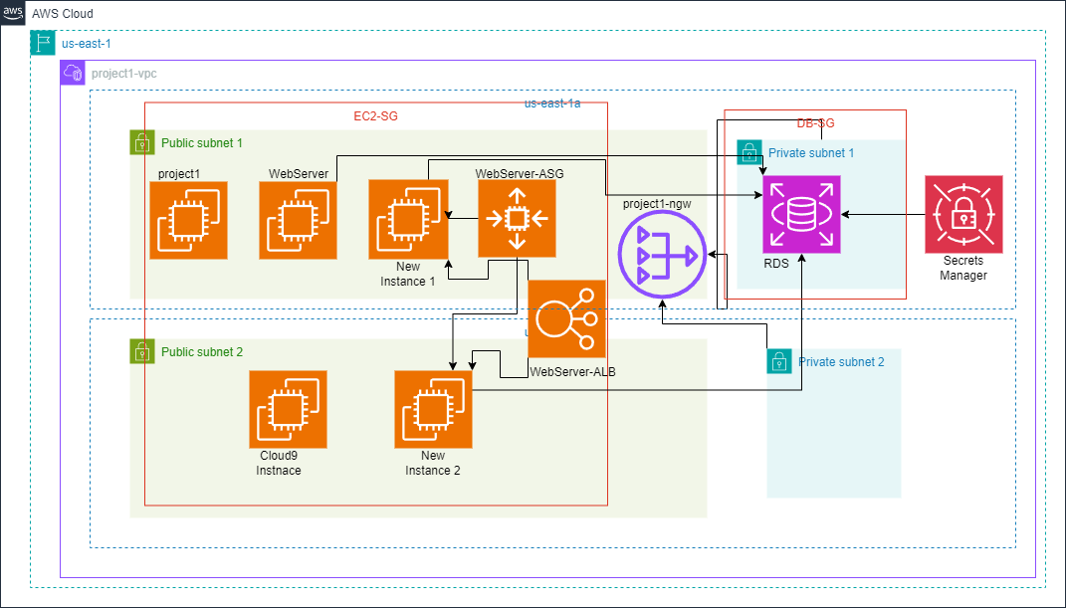
Phase 1: Planning the design and estimating cost
Task 1: Creating an architectural diagram

Slide 5
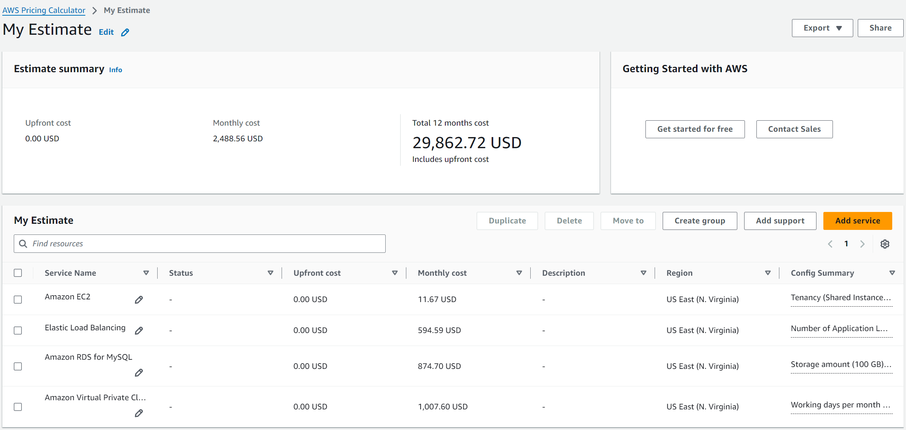
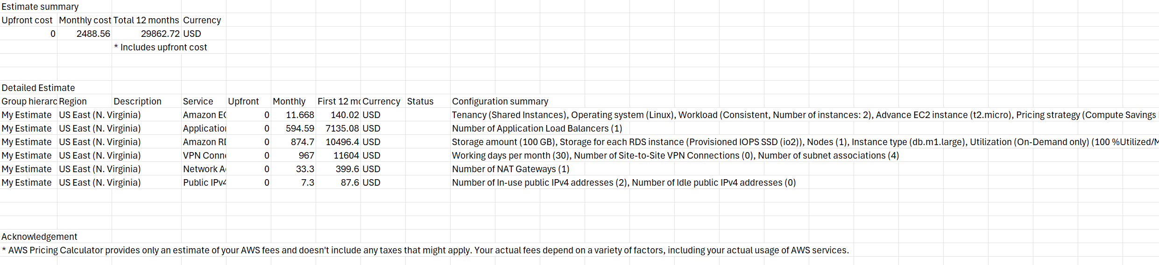
Task 2: Developing a cost estimate

Slide 6
Phase 2: Creating a basic functional web application
Task 1: Creating a virtual network
We created VPC.
We then create NAT Gateway in the public subnet 1.
We then go to route tables and add new route for anywhere (0.0.0.0/0) to exit from NAT gateway in the private subnet 1.
Then do the same for private subnet 2.
Task 2: Creating a virtual machine
We will create an EC2 instance. We will select Ubuntu as Operating system and we will create a security group to allow SSH and HTTP connections from anywhere (0.0.0.0/0).
Task 3: Testing the deployment
And we can test that the web application is running successfully by going to the public IP in new browser window.

Slide 7
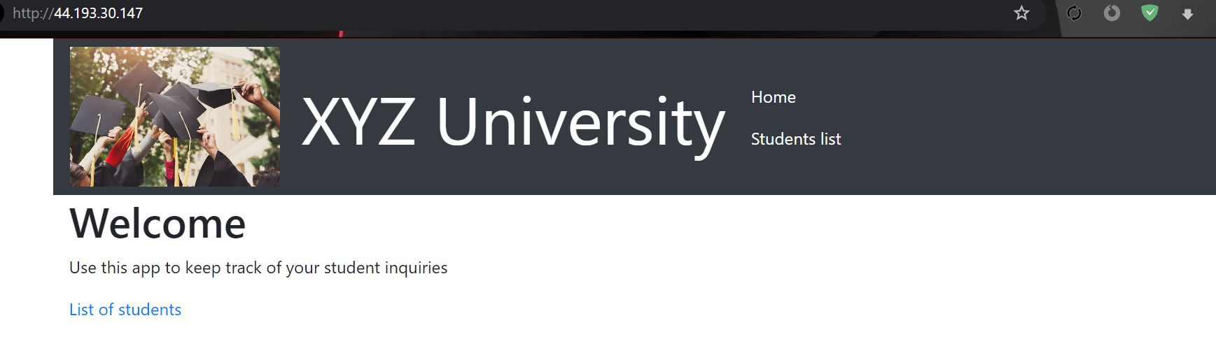

Slide 8
Phase 3: Decoupling the application components
The objective is to separate the database and the web server infrastructure so that they run independently. The web application should run on a separate virtual machine, and the database should run on the managed service infrastructure.
Task 1: Changing the VPC configuration
Create private subnets in two Availability Zones. (We already created them in phase 2)
Task 2: Creating and configuring the Amazon RDS database
We create new database from RDS dashboard. We will choose MySQL engine.
Task 3: Configuring the development environment
Created cloud9 environment on a new t3.micro instance and the platform is Ubuntu and the access is SSH. And Installed AWS CLI on it.

Slide 9
Task 4: Provisioning Secrets Manager
Created new secret using CLI in the cloud9 session.
Task 5: Provisioning a new instance for the web server
Created new instance and added the script of the web application.
And edited the security group for EC2 instances to allow traffic through port 3306.
Also created a security group for the RDS instance and allowed inbound traffic on port 3306.
Tested the web app is working fine.
Task 6: Migrating the database
Migrate the data from the original database, which is on an EC2 instance, to the new Amazon RDS database.
First add some data on the website (on the old EC2 instance’s public IP)
Then, we will export the data from the old EC2 instance. Then we will put it in the RDS instance.
Task 7: Testing the application
I went to the newly created EC2 instance and then found the data migrated which means the application can access it from RDS instance.

Slide 10
Phase 4: Implementing high availability and scalability
Task 1: Creating an Application Load Balancer
Created image from the Webserver instance.
Create a launch template.
Then create the Automatic Scaling Group. I set the desired capacity to two as I want two instances to run in the two public subnets (one per each).
If we check the EC2 dashboard, you can see that there two new instances have been created in the EC2 dashboard (because we set the desired capacity to 2 instances).
Create a target group and include the two created instances.
Then we will create the Application Load Balancer.
And now the targets are receiving monitoring and their status became healthy

Slide 11
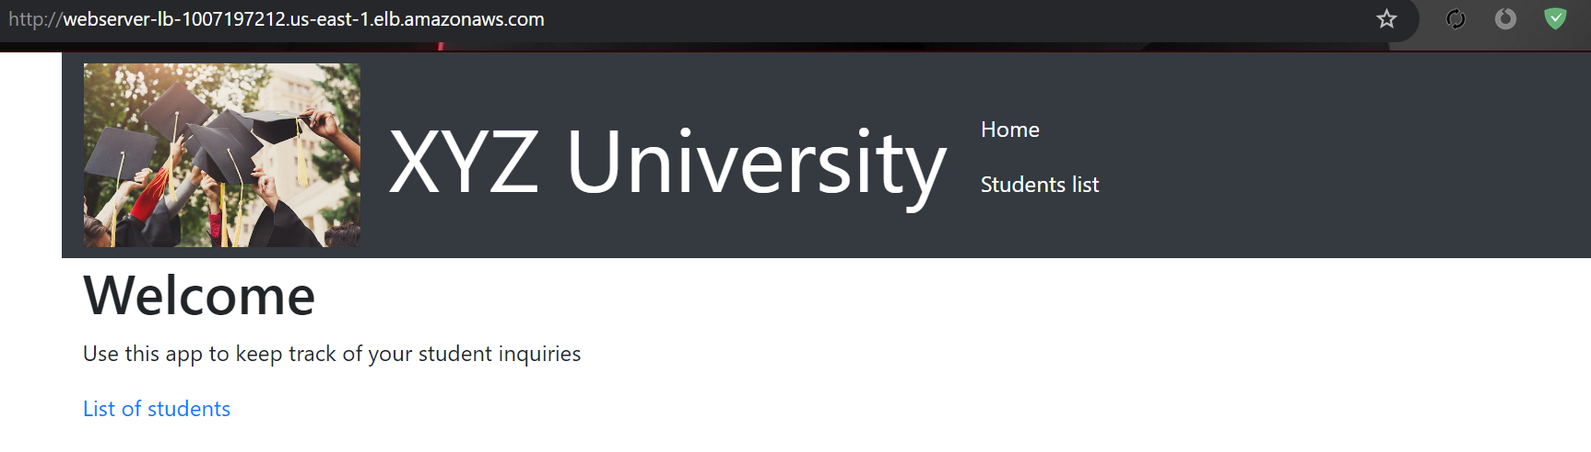
Task 2: Implementing Amazon EC2 Auto Scaling
Created the Auto Scaling Group in the previous step.
Task 3: Accessing the application
By using the public DNS name of the Application Load Balancer, we can test that we can access the application. And we will find the data from the RDS instance.

Slide 12
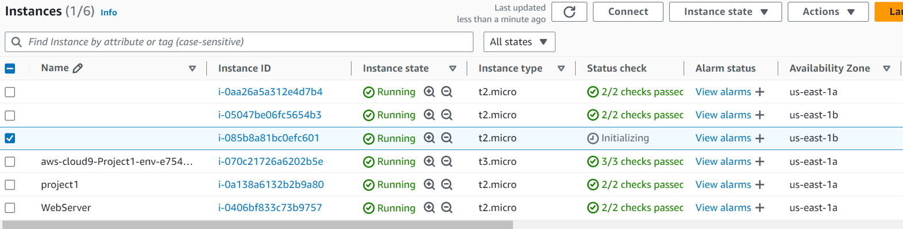
Task 4: Load testing the application
We will now try doing load testing on the Application Load Balancer that we created. So we will install the loadtest package using the below command.
Then we will run the loadtest command on the ALB.
Then we will wait till the Auto Scaling Group create a new instance.

Slide 13
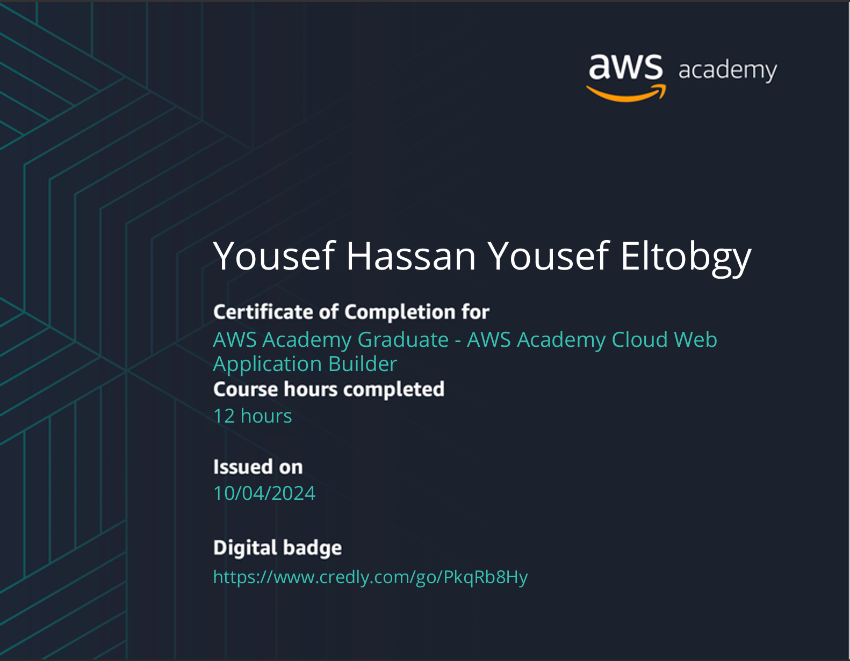
The Badge

Slide 14
Project 2 -- Securing and Monitoring Resources with AWS

Slide 15
Introduction
By the end of this project, you should be able to do the following:
Secure access to objects in an Amazon Simple Storage Service (Amazon S3) bucket.
Secure network access to your virtual network.
Encrypt data at rest by using AWS Key Management Service (AWS KMS) on an Amazon Elastic Block Store (Amazon EBS) volume.
Manage encryption keys by using AWS KMS.
Create a monitoring and incident response system by using Amazon CloudWatch and AWS Config.

Slide 16
Phase 1: Securing data in Amazon S3
You have been asked to secure customer PII data that is stored in Amazon S3.
Task 1.1: Create a bucket, apply a bucket policy, and test access
Created the bucket and uploaded a file.
I added a policy to allow all Amazon S3 service actions for all principals for data-bucket and all objects in it, only for the ARN equals the ARN for the voclabs IAM role, the paulo IAM user, or the sofia IAM user.
Then confirmed the Paulo can access, while Mary whom I didn’t put her ARN in the policy to allow her to make actions in the bucket, can’t view its content.
Task 1.2: Enable versioning and object-level logging on a bucket
Enabled the versioning on the bucket.
Enabled the Server access logging on the bucket.
I verified that the policy in the bucket allows the whole account to add files in the bucket so there would be no problems when the data bucket put the logs in it.

Slide 17
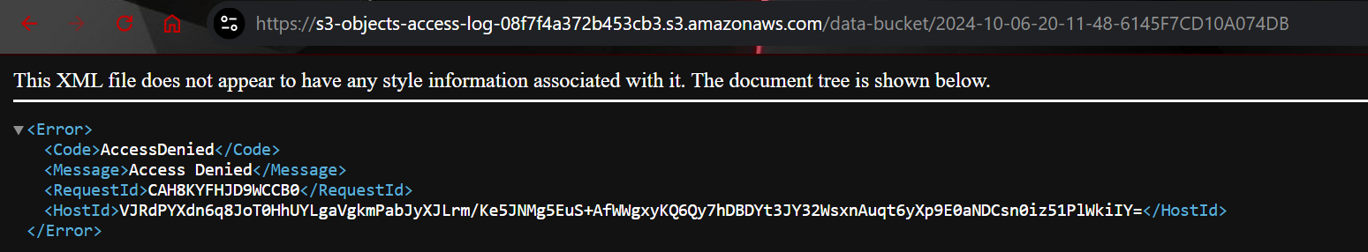
Task 1.3: Implement the S3 Inventory feature on a bucket
Created the inventory for our data-bucket, and the destination is the “s3-inventory” bucket.
Task 1.4: Confirm that versioning works as intended
Created a file named “customers.csv” with some data in it. Then I uploaded the file with the user named Paulo.
Then I made the some changes in the file. Then uploaded it again. Confirmed that the versioning is working, the same file has two versions.
Tried to log in with the user named Mary to make logs of unauthorized access. The logs folder was created successfully automatically and the logs were put inside it.
And the deny log appeared as per below.

Slide 18
Task 1.5: Confirm object-level logging and query the access logs by using Athena
I downloaded one of the log files and this is what is inside it.
Then I created a bucket for athena results.
Then created a workgroup and configured it to store the results in the “athena results” bucket.
Then used the query to get records for actions taken as the paulo user, because that user can access the bucket and its objects.

Slide 19
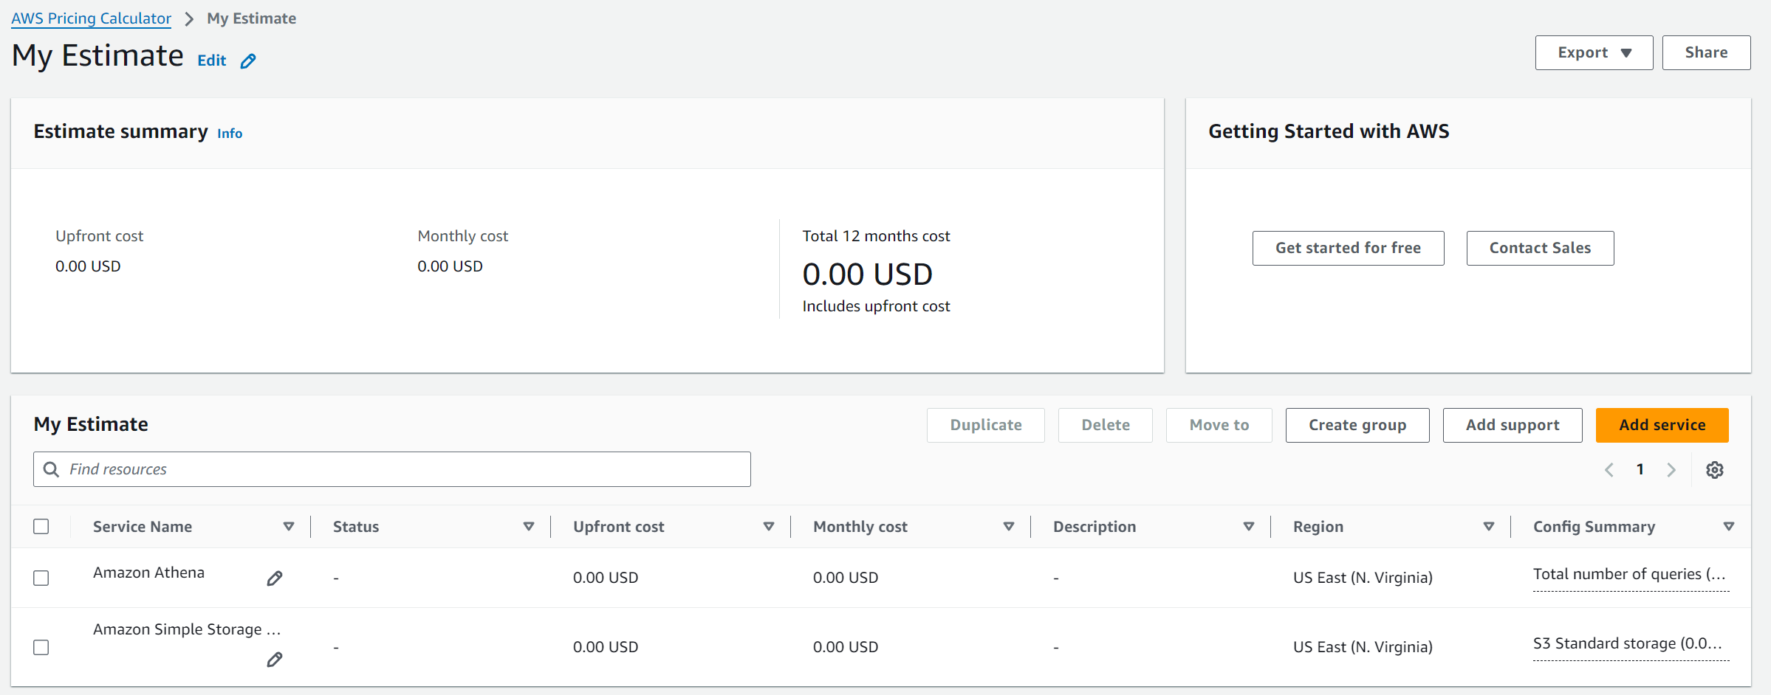
Cost assessment to secure Amazon S3

Slide 20
Phase 2: Securing VPCs
Task 2.1: Review LabVPC and its associated resources
I analyzed the resource map of the existing LabVPC. It contains the following resources: A subnet named WebServerSubnet, A route table which is the main route table that is created by default for any VPC, and an internet gateway.
And reviewed the permissions that are granted to the “VPCFlowLogsRole” IAM role.
Task 2.2: Create a VPC flow log
Created VPC flow logs in our “LabVPC”. And I put the Destination log group to the CloudWatch group named “LabVPCFlowLogs”.
Task 2.3: Access the WebServer instance from the internet and review VPC flow logs in CloudWatch
Tried to access the web server instance from its public IP but it is not reachable.
Tested the connectivity to it from port 80 but the command is loading and will lead to timeout. It means that it can’t reach the instance from port 80. I also tried testing connection for port 22 but same problem.
There are many logs in the log group. And Message field for all entries indicate “Reject”.
I filtered the logs with the cloud9 IP to get the logs related to it

Slide 21
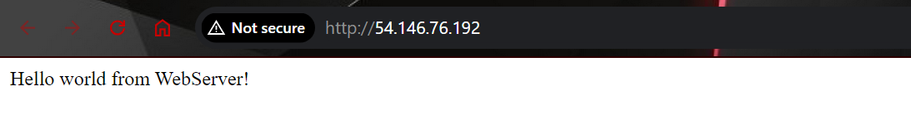
Task 2.4: Configure route table and security group settings
I edited the security group for the web server instance to allow the HTTP from anywhere (0.0.0.0/0) and SSH from an IP range that EC2 Instance Connect uses in the us-east-1 Region. I also deleted unnecessary rules.
If we test from the cloud9 instance again, it will still not work.
So I added route in the route table that is associated with the web server instance to route traffic through the internet gateway.
And now it succeeded. And we can access the webserver from the browser window. And the SSH is working too through EC2 instance connect.

Slide 22
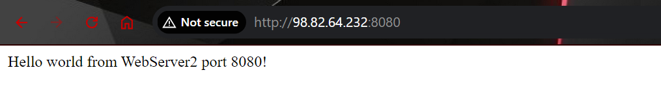
Task 2.5: Secure the WebServerSubnet with a network ACL
If I edited the rule number 100 from allow to deny the connection through port 22 will fail. And it really failed from the cloud9 instance.
So now we allow the traffic on ports 80 and 22 in the NACL. And connection worked again fine.
Task 2.6: Review NetworkFirewallVPC and its associated resources
The NACL of the two subnets allow all traffic. The WebServer2 instance is deployed in this VPC and it is reachable fine. And connection is working fine from the cloud9.
I then tested the connection on port 8080 so I had to run the command in the WebServer2 instance to start the web server on 8080.
And then it will work fine.

Slide 23
Task 2.7: Create a network firewall
I created firewall in the us-east-1a Availability Zone for FirewallSubnet and IP address type IPv4. And Named the firewall policy as FirewallPolicy.
Task 2.8: Create route tables
Created the route tables and added route where I set the destination to be the CIDR block of the subnet that the WebServer2 instance runs in, and I set the target to the only Gateway Load Balancer Endpoint that is available.
I then added an edge association to the IGW-Ingress-Route-Table so that the NetworkFirewallIG internet gateway is associated with the route table.
I then created a new route table. Then I associated it with the subnet named “FirewallSubnet”.
Then I created another route table named "WebServer2-Route-Table”. And added a route so that 0.0.0.0/0 traffic is routed to the Gateway Load Balancer Endpoint. Then created association between the “Webserver2Subnet” subnet and the route table

Slide 24
Task 2.9: Configure logging for the network firewall
I created a log group
I then configured logging in the firewall that we created. The webserver2 will not be accessible. This is expected because the network firewall policy isn’t yet configured to allow HTTP traffic on port 80.
And we can check the logs in the cloudwatch log group “NetworkFirewallVPCLogs”.
Task 2.10: Configure the firewall policy and test access
I then created a stateful route group in the firewall policy to allow connection on port 80, 22, 443 and ICMP protocol, but I set it to reject connection on port 8080.
And now the WebServer2 is accessible again on ports 80 and 22. The ICMP is also working fine.
But if we tried to access on port 8080, the connection will fail because of the firewall rule.

Slide 25
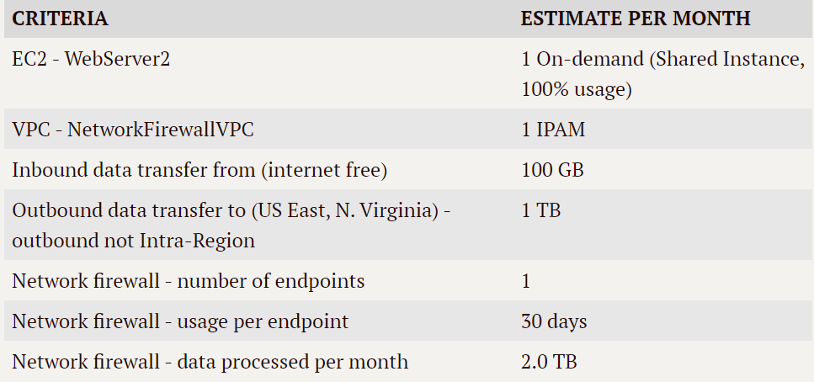
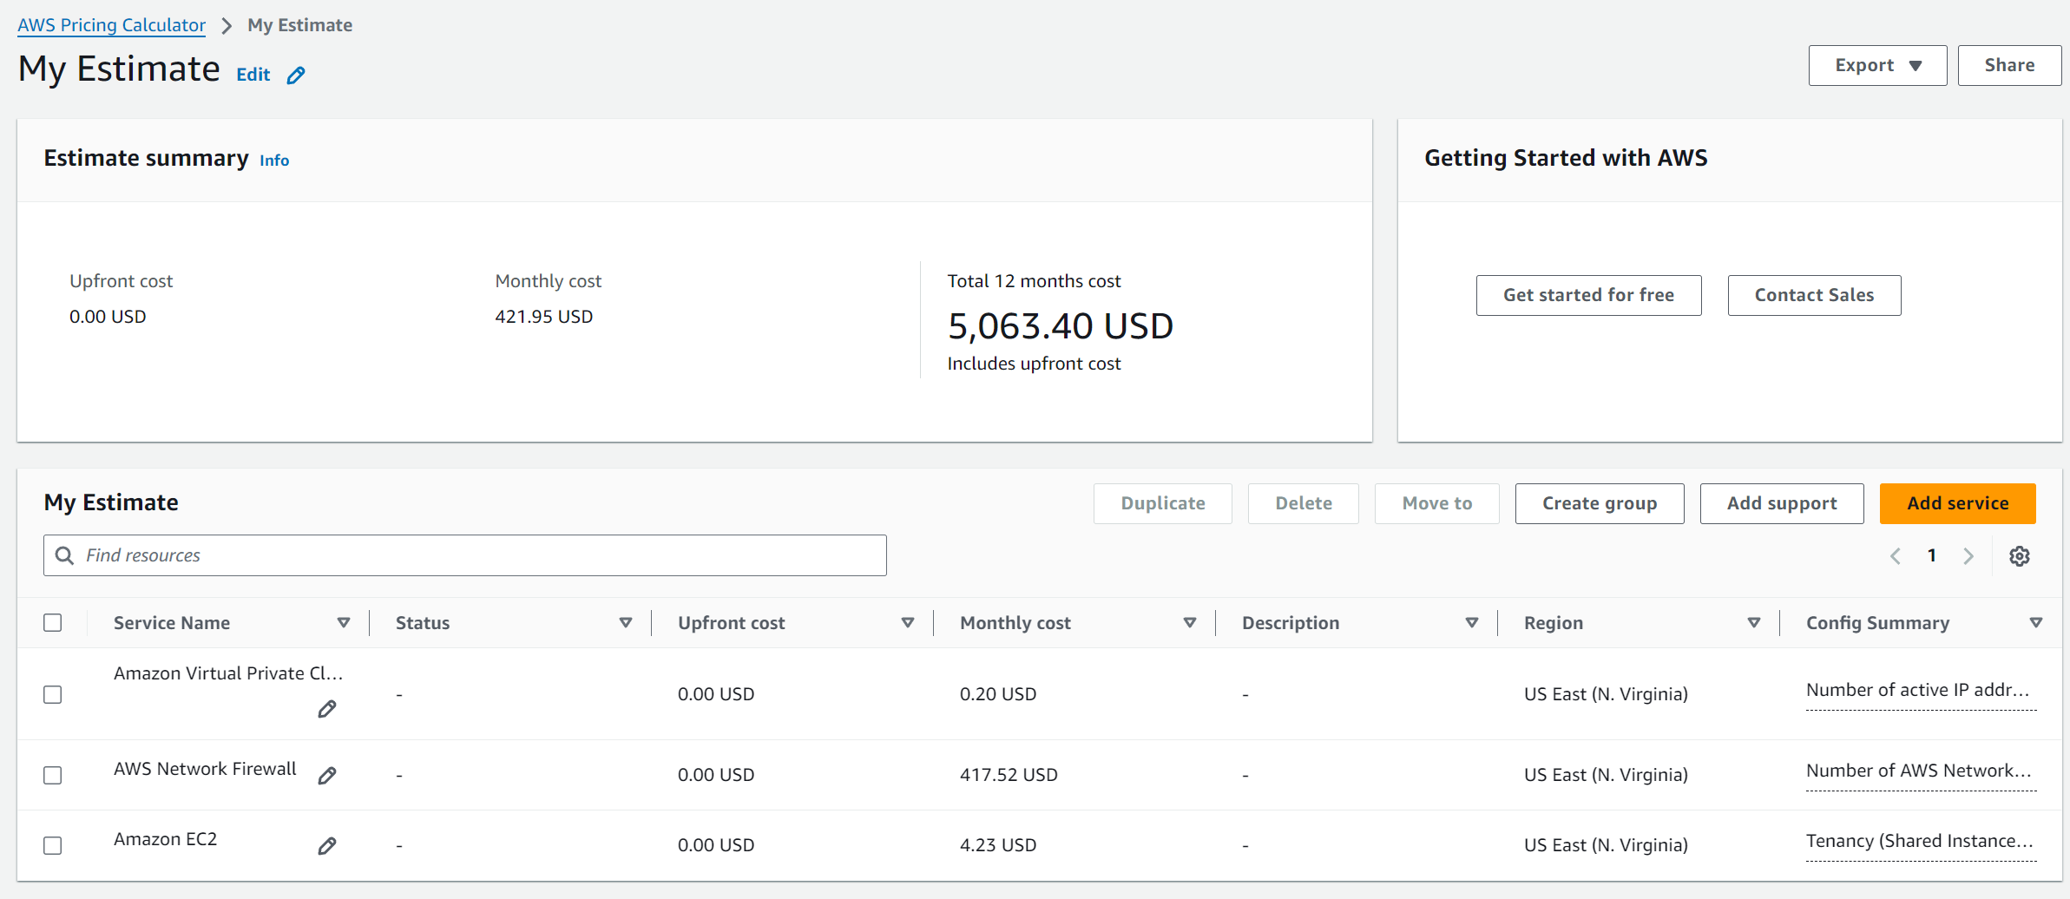
Cost estimate to secure a VPC with a network firewall

Slide 26
Phase 3: Securing AWS resources by using AWS KMS
Task 3.1: Create a customer managed key and configure key rotation
Created a new key and granted the Key administrator and Key user permissions to the voclabs role
I then enabled the automatic key rotation. So that it is automatically rotated every year.
Task 3.2: Update the AWS KMS key policy and analyze an IAM policy
Added user named Sofia to the key administrators
I analyzed the policy named “PolicyForFinancialAdvisors”, It is configured to allow full actions on S3 (like PUT, GET, etc.) and also allow some actions, like: encrypt, decrypt, etc.

Slide 27
Task 3.3: Use AWS KMS to encrypt data in Amazon S3
Modified the encryption settings on the data-bucket S3 bucket so that the bucket uses SSE-KMS encryption.
Created a file named “loan-data.csv” with some data. I uploaded it to the S3 bucket using the user named “Sofia”. And The encryption type for the object is SSE-KMS.
I successfully downloaded the file using the user Sofia. This means that the user can retrieve the KMS key and detect the file on S3 bucket and download the file in plain text.
If I try to open the file using the user Paulo, it will result in error and tell me the user is not authorized to perform: kms:Decrypt on resource.
Task 3.4: Use AWS KMS to encrypt the root volume of an EC2 instance
I created new EC2 instance and enabled encryption on its AMI root volume by using MyKMSKey.

Slide 28
Task 3.5: Use AWS KMS envelope encryption to encrypt data in place
I connected to the webserver2 instance and created a file in it.
I ran commands to generate a data key for the MyKMSKey, saved it to a bash variable, and then echoed the data key details in JSON format. Then saved the data key to disk.
Task 3.6: Use AWS KMS to encrypt a Secrets Manager secret
Created a new secret
Then I used EC2 Instance Connect to connect to the WebServer2 instance, and then used the AWS CLI to retrieve the secret.

Slide 29
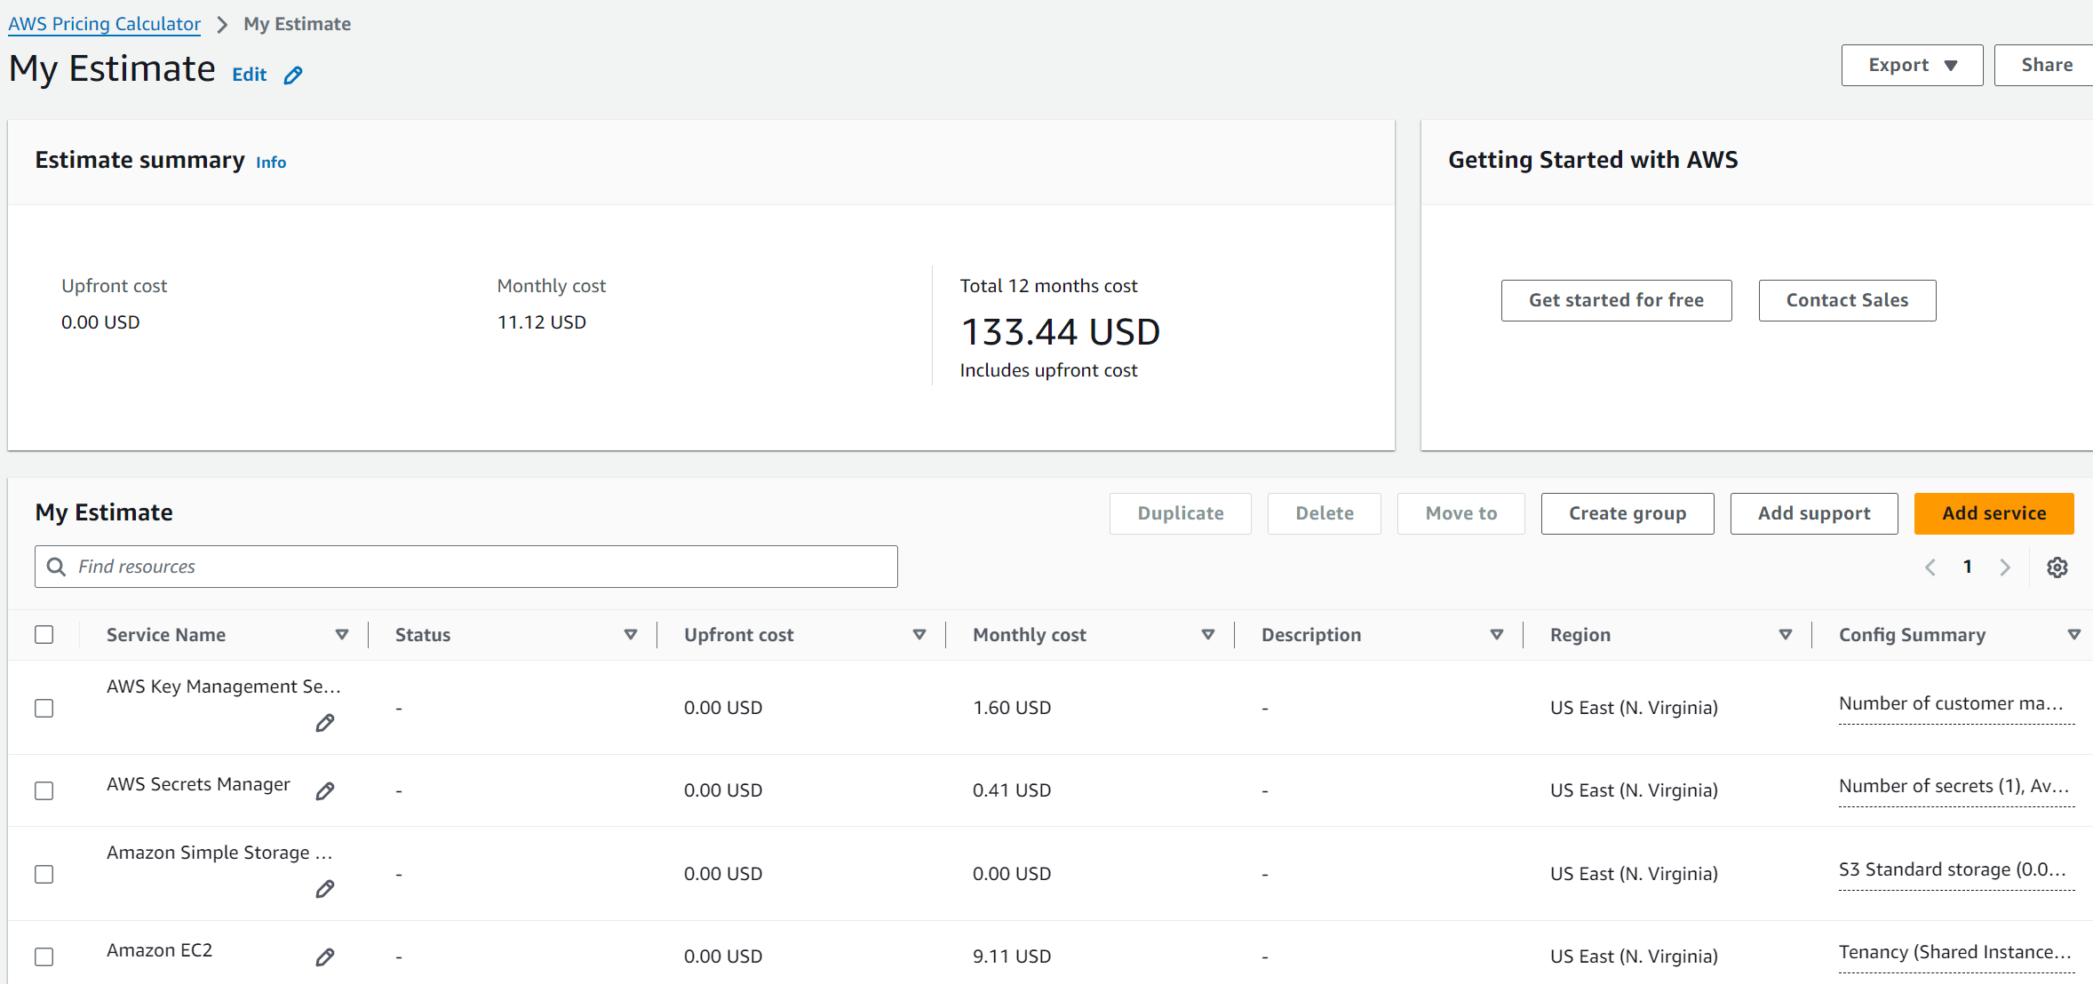
Cost assessment for using AWS KMS

Slide 30
Phase 4: Monitoring and logging
Task 4.1: Use CloudTrail to record Amazon S3 API calls
Created a new CloudTrail trail. It will store the logs in the existing cloudtrail-logs S3 bucket. It will record both management events and data events in the trail. And for data events, it will log all S3 events.
Created a new file locally named “customer-data.csv” with contents.
Created an Athena table that describes the format of the data in the cloudtrail-logs S3 bucket.
I ran an Athena query to retrieve the CloudTrail event log data for when I uploaded the customer-data.csv file to Amazon S3. I also created a similar Athena query to retrieve the CloudTrail log information for when I opened (or downloaded) the customer-data.csv file.

Slide 31
Task 4.2: Use CloudWatch Logs to monitor secure logs
I created a new CloudWatch log group.
Then I used EC2 Instance Connect to connect to EncryptedInstance, and installed the CloudWatch agent and a Linux daemon named collectd, which the CloudWatch agent will use. Then I downloaded and configured a JSON file that provides configuration details for the CloudWatch agent.
Then I started the CloudWatch agent, and confirmed that it is running
Then I uploaded the key to the cloud9 instance
Then I became able to SSH to the EncryptedInstance instance from the cloud9 instance. But if I tried with user “ubuntu”, it will result in permission denied. Because it doesn't exist on this Amazon Linux instance.
And there were logs that recorded the successful connection from ec2-user, and the failed request from user ubuntu.

Slide 32
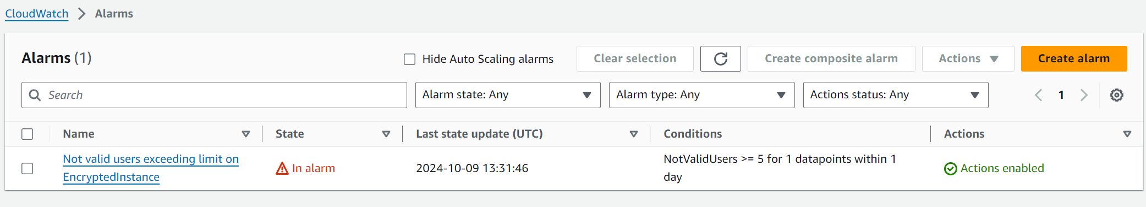
Task 4.3: Create a CloudWatch alarm to send notifications for security incidents
Created a new metric filter in the EncryptedInstanceSecureLogs CloudWatch log group.
Created a CloudWatch alarm from the metric filter that I just created. It will send a notification for Not valid access attempts over SSH to the EncryptedInstance server are greater than or equal 5 in the last 24 hours. And confirmed the subscription.
I made five invalid SSH access attempts to connect to the EncryptedInstance public IP address over SSH, and checked they were recorded in the logs.
Also the CloudWatch alarm became in “in alarm” state. Plus I received a notification on the mail.

Slide 33
Task 4.4: Configure AWS Config to assess security settings and remediate the configuration of AWS resources
I have two roles the first role grants permissions that you will need to set up AWS Config, and the second role is the role that AWS Systems Manager will use when it performs remediation actions with an AWS Config managed rule that you will use.
I also have a bucket that AWS Config will use this bucket for logging purposes.
I created another bucket. Then I edited the object ownership in the “s3-objects-access-log” bucket. I enabled ACLs.
Then I set up AWS Config to record all current and future resources that are supported in the us-east-1 Region.
Confirmed that the s3-bucket-logging-enabled rule that I defined is finding resources that are in scope. I also confirmed that the compliance-bucket is flagged as noncompliant. The compliance-bucket is flagged as Noncompliant, that is because the “server access logging” is disabled.

Slide 34
Then I configured manual remediation settings for the s3-bucket-logging-enable rule.
Then to test this, I select the “compliance bucket” bucket and then chose “remediate” button. That is to invoke the AWS Config remediation action so that object logging is enabled on the “compliance-bucket”.
Then I confirmed that the server access logging is now enabled on the compliance-bucket. It was enabled by the remediation rule that I just ran.

Slide 35
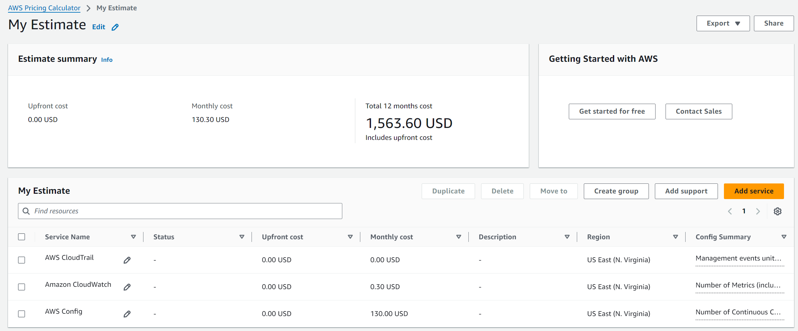
Cost assessment for monitoring and logging

Slide 36
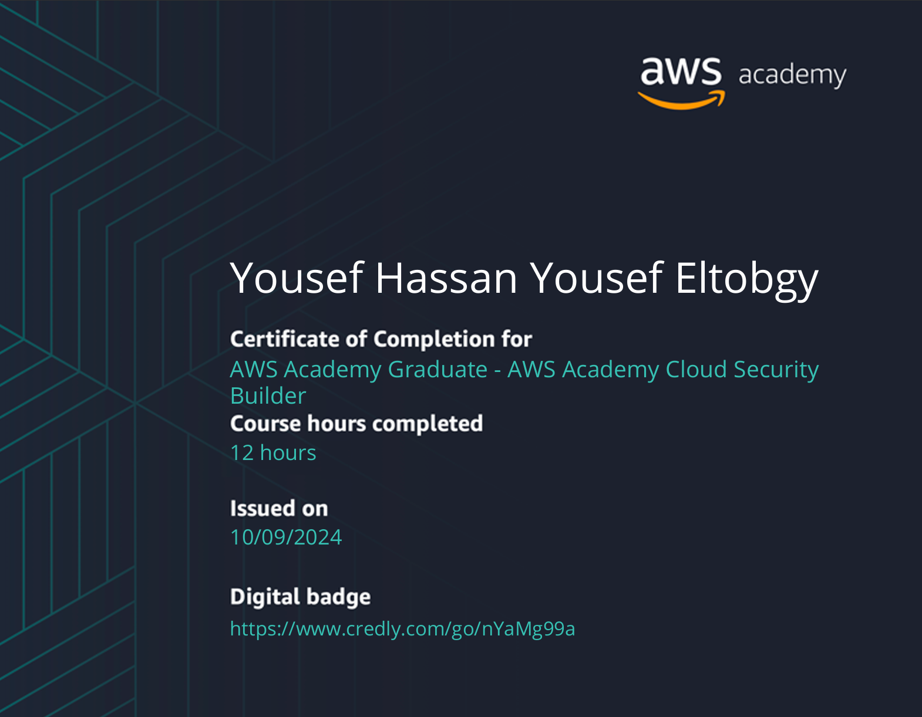
The Badge

Slide 37
Thank You

